Slide 1
Quantum Implementation of GANs and comparison with its classical counter
Presented by:
Samya Sunibir Das (1911563042)
Nazmul Hasan (1911742042)
Sabiha Hossain (1911017042)

Slide 2
Introduction
Generative Adversarial Networks, or GANs for short, are an approach to generative modeling using deep learning methods, such as convolutional neural networks. Generative modeling is an unsupervised learning task in machine learning that involves automatically discovering and learning the regularities or patterns in input data in such a way that the model can be used to generate or output new examples that plausibly could have been drawn from the original dataset.
qGAN implementation learns and loads probability distributions into quantum states. More specificially, the aim of the qGAN is not to produce classical samples in accordance with given classical training data but to train the quantum generator to create a quantum state which represents the data’s underlying probability distribution.

Slide 3
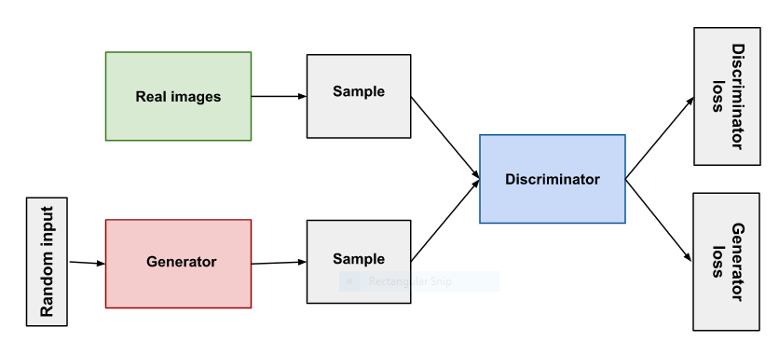
GAN in Depth
A generative adversarial network (GAN) has two parts:
The generator learns to generate plausible data. The generated instances become negative training examples for the discriminator.
The discriminator learns to distinguish the generator's fake data from real data. The discriminator penalizes the generator for producing implausible results.

Slide 4
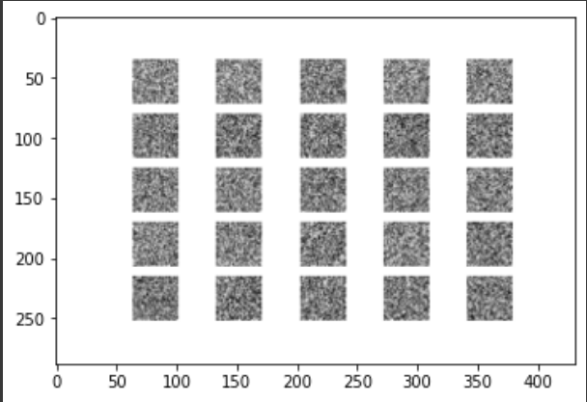
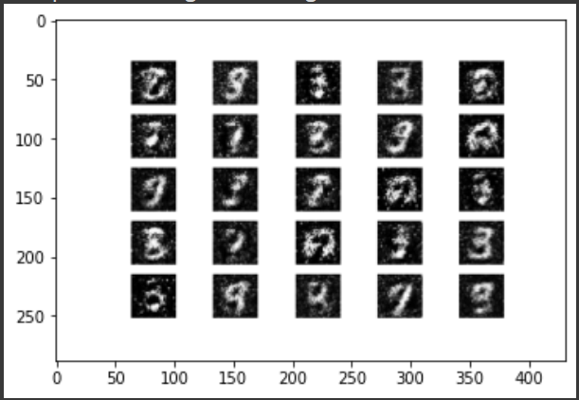
Classical GAN applied on the MNIST dataset
At epochs = 0
At epochs = 1000

Slide 5
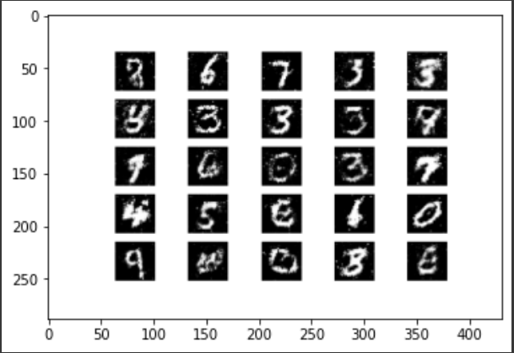
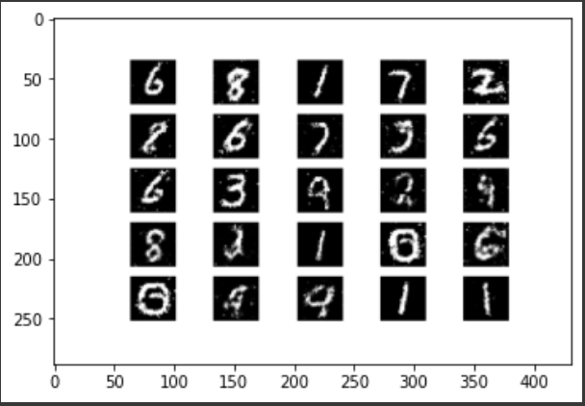
At epochs = 5000
At epochs = 10000

Slide 6
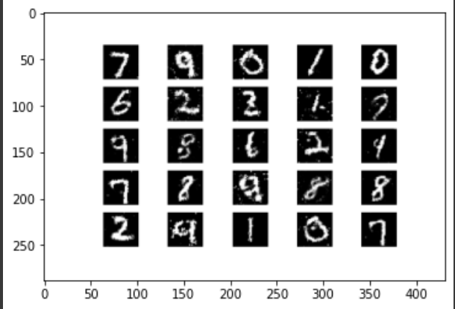
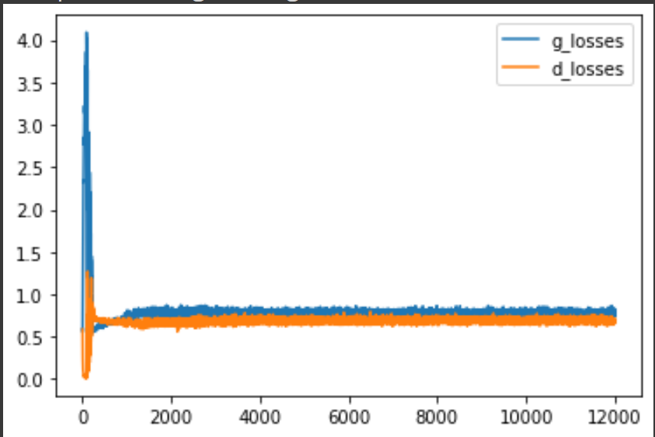
Finally at epochs = 11800
Generator vs Discriminator Loss Curve

Slide 7
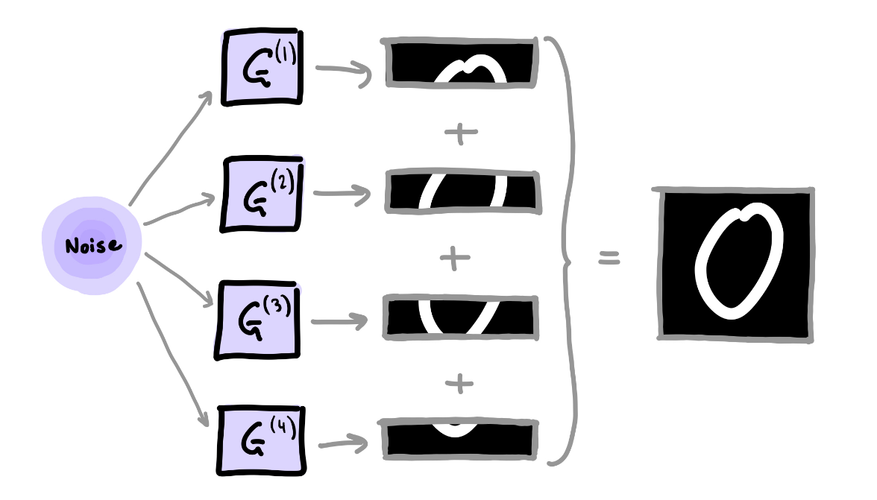
Quantum GAN implementation: Patch Method

Slide 8

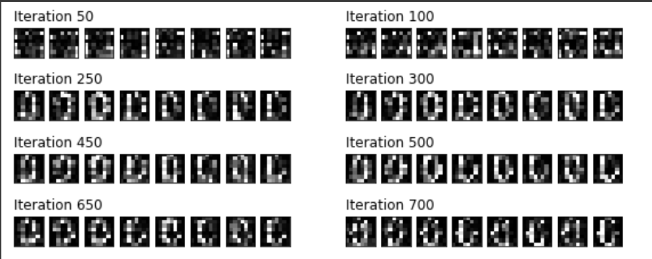
Results: Patch Method
Sample 0s in the dataset
Generated Results for 0s for 700 epochs

Slide 9

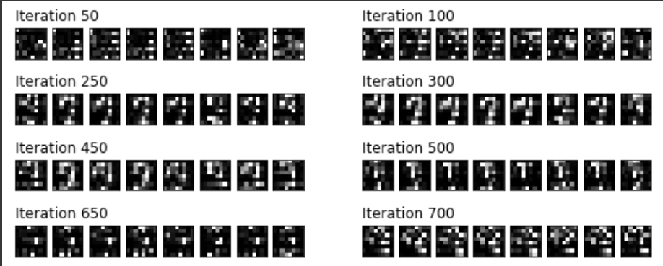
Results: Patch Method
Samples for 9s in Dataset
Generated Results for 9s until 700 epochs

Slide 10
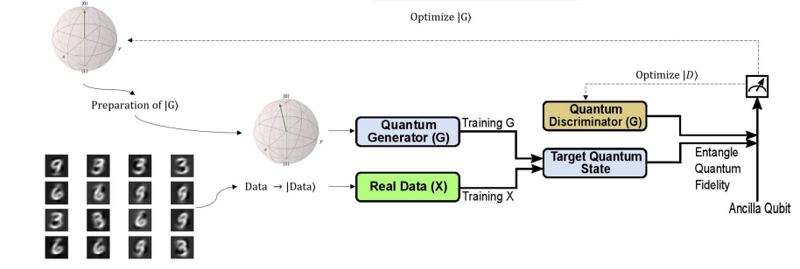
Quantum State Based

Slide 11
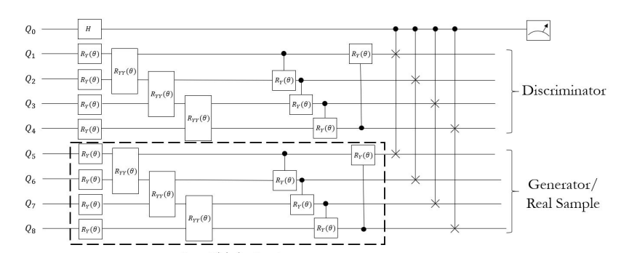
Structure

Slide 12
MinMax Loss
Discriminator: maximize log D(x) + log(1 – D(G(z)))
Generator: minimize log(1 – D(G(z)))

Slide 13
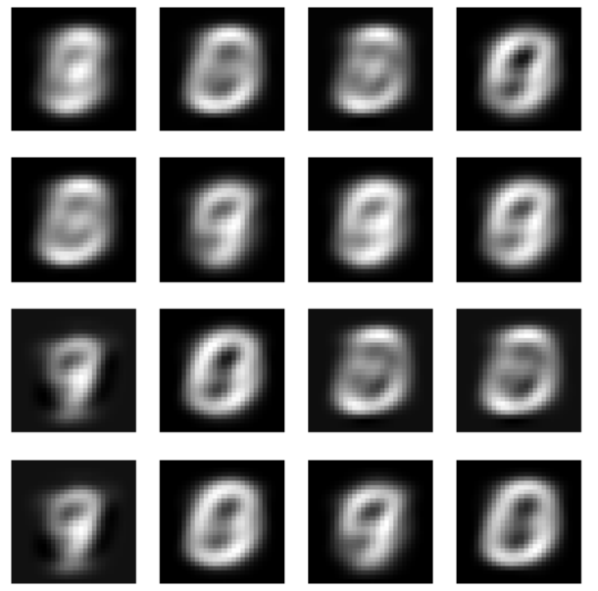
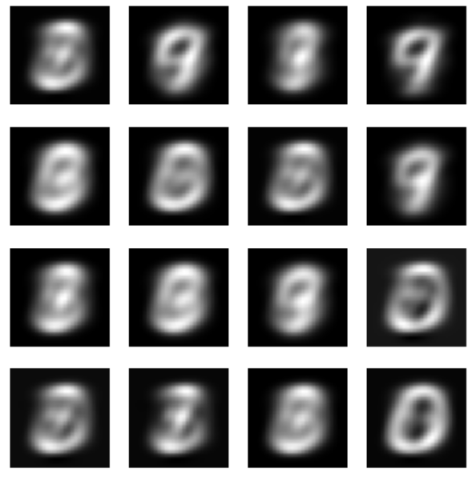
Results
Epoch 1
Epoch 20

Slide 14
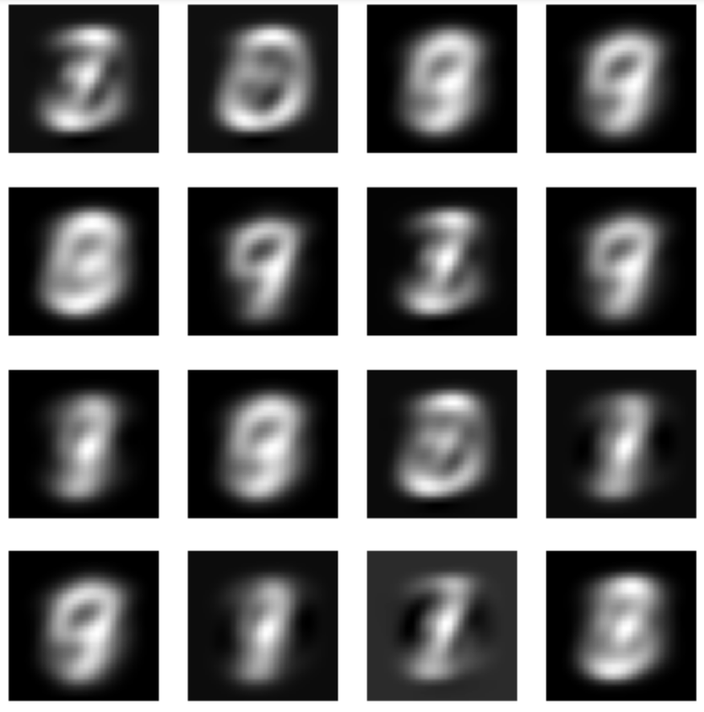
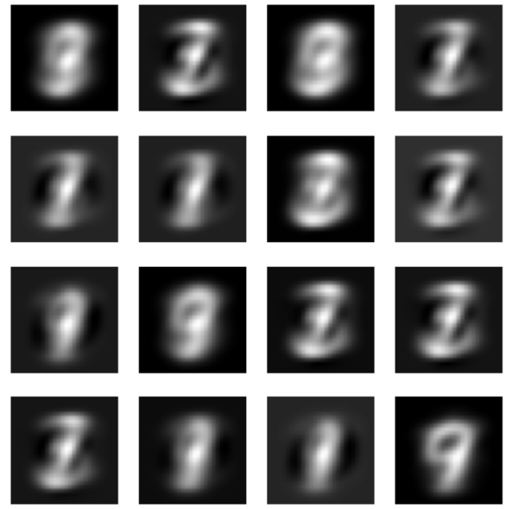
Results
Epoch 50
Epoch 70

Slide 15
THANK YOU!

